Slide 1

SUBJECT CODE
TYPE THE SUBJECT NAME HERE
PREVENTING POISONING ATTACKS IN ML USING CYBER SECURITY APPLICATIONS
DATE: 15.11.2021
BATCH NUMBER : 1
PROJECT CODE : SEC24ITTE30101
BATCH MEMBER : GNANA PADMESH C K, LOKESH V
SUPERVISOR : DR SHEELA T,
HOD, IT, DEAN OF NETWORKING.
II
III
20ITTE301- LIVE IN LAB

Slide 2

20ITTE301
LIVE IN LAB
INTRODUCTION
Machine learning methods have been becoming popular and the usage areas of these methods have also increased with this popularity.
Machine learning technologies have proven highly beneficial for massive development in various sectors, but it has many vulnerabilities as well.
One such major vulnerability is poisoning attacks on the models of machine learning.
Poisoning attacks are considered one of the most relevant emerging threats against machine learning.
A poisoning attack happens when an attacker injects malicious or unwanted data into the machine learning model’s training pool.
Poisoning attacks target the model through either ML’s availability or its integrity.

Slide 3
20ITTE301
LIVE IN LAB
ABSTRACT
Our project comes under SDG Goal number 9 - Industry, Innovation, and Infrastructure.
It revolves around the detection and prevention of poisoning attacks on the models of machine learning by either Anomaly detection or cryptographically based authentication and provenance.
Anomaly detection is an application of cybersecurity where it identifies the rare occurrence of any unfamiliar data from the model.
Through cryptographic authentication, a person who creates the model holds the cryptographic key, through which the attacks can be prevented.

Slide 4
20ITTE301
LIVE IN LAB
Literature Review
S.No. | Journal Details | Authors & Title of the Paper | Inference of the Paper
1 | 2018 IEEE Symposium on Security and Privacy (SP) | Manipulating Machine Learning: Poisoning Attacks and Countermeasures for Regression Learning Matthew Jagielski, Alina Oprea, Battista Biggio, Chang Liu, Cristina Nita-Rotaru, and Bo Li. | They proposed a new theoretically-grounded optimization framework for poisoning attacks. They designed a new principled robust defense method that is highly resilient against all poisoning attacks. They evaluated their defense algorithms on several datasets
2 | 2017 Research Gate | A “Poisoning” Attack Against Online Anomaly Detection Marius Kloft and Pavel Laskov | Analyzing the robustness of online anomaly detection with limited horizon against poisoning attacks. For testing it, the authors have used Optimal Greedy Attack algorithm. Their experimental evaluation showed that online anomaly detectors are unsecure for attacks in high-dimensional network data

Slide 5
20ITTE301
LIVE IN LAB
Literature Review
S.No. | Journal Details | Authors & Title of the Paper | Inference of the Paper
3 | 2017 Proceedings of the 10th ACM Workshop on Artificial Intelligence and Security | Mitigating Poisoning Attacks on Machine Learning Models: A Data Provenance Based Approach Nathalie Baracaldo ,Bryant Chen, Heiko Ludwig and Jaehoon Amir Safavi | Methodology uses contextual information about the origin and transformation of data points in the training set to identify poisonous data, thereby preventing online and regularly re-trained machine learning applications. They proposed a defense strategy that makes use of data provenance (includes the data origin, what happens to it and where it moves) to prevent poisoning attacks.
4 | 2021 Research Gate | Preventing Machine Learning Poisoning Attacks Using Authentication and Provenance Kevin Kane, Paul England , Jack W Stokes | Prevention relies on cryptographically-based authentication to ensure the integrity of the data used to train a machine learning model. Proposed VAMP system, to protect media objects such as images, video files or audio clips in the machine learning model.

Slide 6
20ITTE301
LIVE IN LAB
Literature Review
S.No. | Journal Details | Authors & Title of the Paper | Inference of the Paper
5 | 2020 IEEE Journal | Preventing Data Poisoning Attacks By Using Generative Models Merve Aladag, Ferhat Ozgur Catak, Ensar Gul | Demonstrated a data poisoning attack towards MNIST, a widely used character detection data set and they also proposed a defense algorithm which makes machine learning models more robust against data poisoning attacks. Using the poisoned MNIST dataset, they built classification models more reliable by using a generative model such as AutoEncoder.
6 | 2018 Research Gate | Data Poisoning Attacks against Online Learning Yizhen Wang Kamalika Chaudhuri | On preventing Data Poisoning Attacks in both online learning and machine learning they have developed their own algorithm known as Attackers Algorithm with optimization problems. They also inferred the rate of attacks through visual representation by means of graph.

Slide 7
20ITTE301
LIVE IN LAB
S.No. | Journal Details | Authors & Title of the Paper | Inference of the Paper
7 | 2018 IEEE | Detection of Adversarial Training Examples in Poisoning Attacks through Anomaly Detection Andrea Paudice, Luis Munoz-Gonz´alez, Andr´as Gy ¨orgy, and Emil C. Lupus | The authors proposed a defence mechanism to mitigate the effect of these optimal poisoning attacks in a machine learning model based on outlier-detection-based scheme which is capable of detecting the attack points against linear classifiers. Here they have used MNIST dataset for testing and they also stated that performing this outlier detection will be very challenging in high-dimensional datasets,
8 | 2021 IEEE | De-Pois: An Attack-Agnostic Defense against Data Poisoning Attacks Jian Chen, Xuxin Zhang,Rui Zhang, Chen Wang, and Ling Liu. | Proposed De-Pois, an attack-agnostic defense against poisoning attacks. The key idea of De-Pois is to train a mimic model the purpose of which is to imitate the behavior of the target model using Generative Adversarial Networks (GANs) to facilitate informative training data augmentation as well as the mimic model construction.
Literature Review

Slide 8
20ITTE301
LIVE IN LAB
Literature Review
S.No. | Journal Details | Authors & Title of the Paper | Inference of the Paper
9 | 2018 University of California | Targeted Backdoor Attacks on Deep Learning Systems Using Data Poisoning Xinyun Chen, Chang Liu, Bo Li, Kimberly Lu, Dawn Song | The authors highlighted the importance of studying the backdoor poisoning attacks, and developing defense strategies for deep learning and machine learning systems against the backdoor poisoning attacks.They proposed three types of theoretical defense methods, the first one is to simply measure the label distribution of the training data. But it is not very effective while The second one is through an outlier detector, and the third is to evaluate through an additional auxiliary pristine data for deep learning models.

Slide 9
Proposed Methodology with diagram
20ITTE301
Preventing this poisoning attack is through an anomaly detector under the guidance of the anomaly detection software. An Anomaly Detection tool is built using Python and Power BI.
Another method is by using cryptographic key which is developed using Security frameworks and languages such as C and objective C. This cryptographic key is highly securable, and the attackers cannot enter into the model.
Developing a machine learning model
Creating poisoning data
Developing anamoly detector
Combining all three to complete the project

Slide 10
20ITTE301
LIVE IN LAB
MODULES
Module 1
Creating a simple and efficient Machine Learning model
Python language is used to create this model
Module 2
Developing a poisoning data for injecting into the training pool of the machine learning model using Python language.

Slide 11
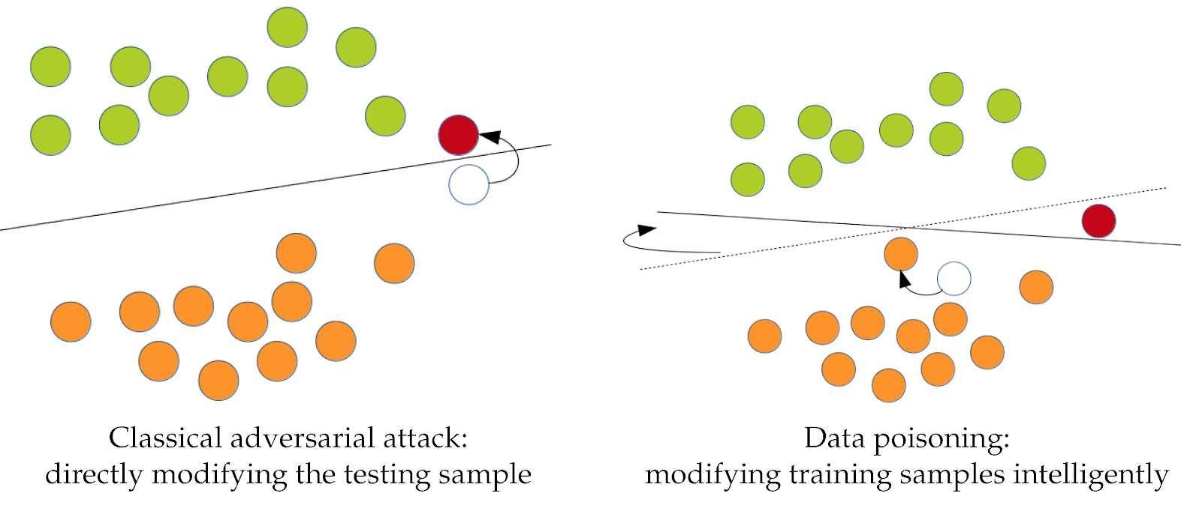
MODULES
20ITTE301
LIVE IN LAB
Module 3
Developing a anomaly detection tool to detect poisoning data.
Creating a cryptographic key for the ML model.
Module 4
Planned for integration testing of all the modules
Deployment

Slide 12





Timeline
Semester 4
Semester 6
There comes our project.
Module 1
Module 3
PROJECT
Module 2
Module 4
Semester 5
Semester 7

Slide 13
20ITTE301
LIVE IN LAB
REFERENCES
[1] Matthew Jagielski, Alina Oprea, Battista Biggio, Chang Liu, Cristina Nita-Rotaru, and Bo Li. Manipulating Machine Learning: Poisoning Attacks and Countermeasures for Regression Learning.
arXiv:1804.00308v3 [cs.CR] 28 Sep 2021
[2] Nathalie Baracaldo, Bryant Chen, Heiko Ludwig, Jaehoon Amir Safavi. Mitigating Poisoning Attacks on Machine Learning Models: A Data Provenance Based Approach. AISec’17, November 3, 2017, Dallas, TX, USA
[3] Merve Aladag, Ferhat Ozgur Catak, Ensar Gu. Preventing Data Poisoning Attacks By Using Generative Models
[4] Andrea Paudice, Luis Munoz-Gonz´alez, Andr´as Gy ¨orgy, and Emil C. Lupus. Detection of Adversarial Training Examples in Poisoning Attacks through Anomaly Detection. arXiv:1802.03041v1 [stat.ML] 8 Feb 2018
[5] Marius Kloft, Pavel Laskov..A “Poisoning” Attack Against Online Anomaly Detection

Slide 14
20ITTE301
LIVE IN LAB
REFERENCES
[6] Yizhen Wang, Kamalika Chaudhuri. Data Poisoning Attacks against Online Learning. arXiv:1808.08994v1 [cs.LG] 29 Aug 2018
[7] Ambra Demontis, Marco Melis, Maura Pintor, Matthew Jagielski*, Battista Biggio, Alina Oprea, Cristina Nita-Rotaru and Fabio Roli. Why Do Adversarial Attacks Transfer? Explaining Transferability of Evasion and Poisoning Attacks
[8]Xinyun Chen, Chang Liu, Bo Li, Kimberly Lu, Dawn Song. Targeted Backdoor Attacks on Deep Learning Systems Using Data Poisoning.
[9] Preventing Machine Learning Poisoning Attacks using Authentication and Provenance.Kevin Kane, Paul England , Jack W Stokes .arXiv:2105.10051v1 [cs.CR] 20 May 2021

Slide 15
FIRST MODULE
Our project’s first module deals with a machine learning model.
For this project, we need a simple, efficient ML web app/model. Our project is of the cyber security domain, so this is just a part of it.
We have designed an ML web app using PyCharm with the help of libraries such as: Pandas, Numpy, SciKitLearn, StreamLine, Pillow.
To create this web app, we have used a predefined data set which deals with Diabetes Analysis and prediction.

Slide 16
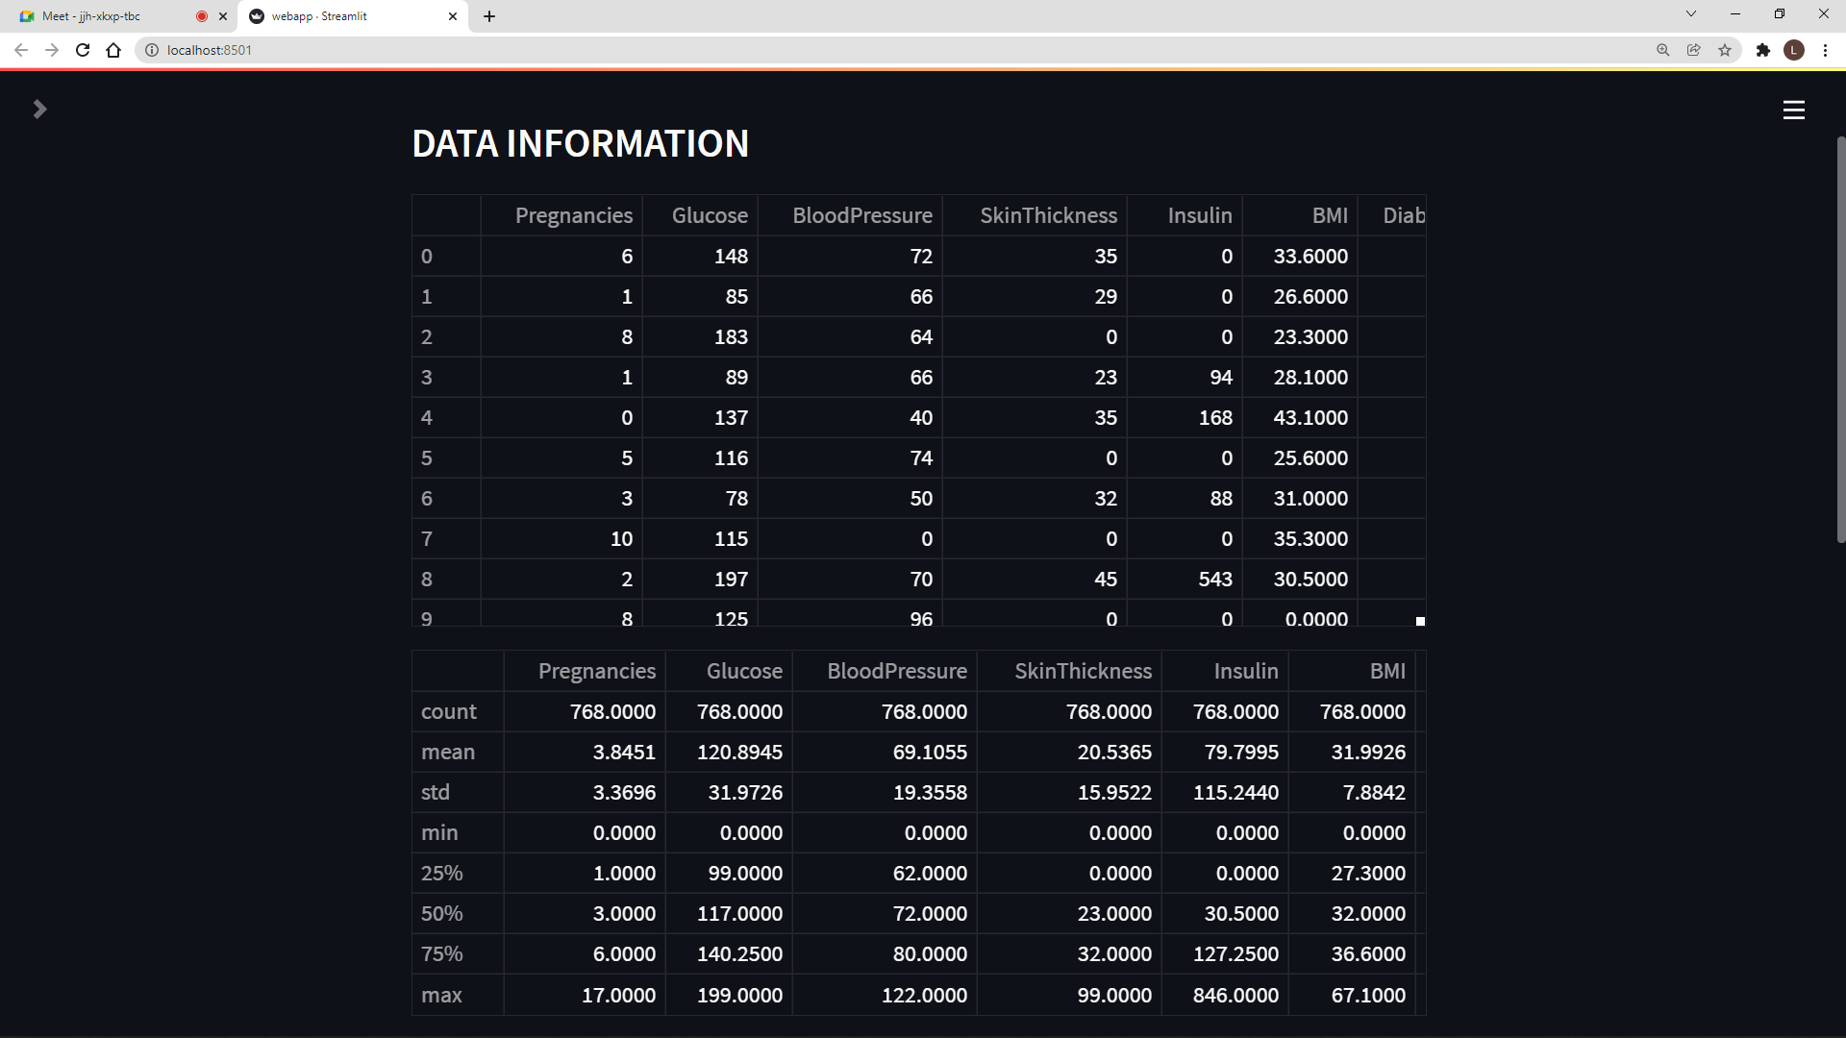
SCREENSHOT

Slide 17
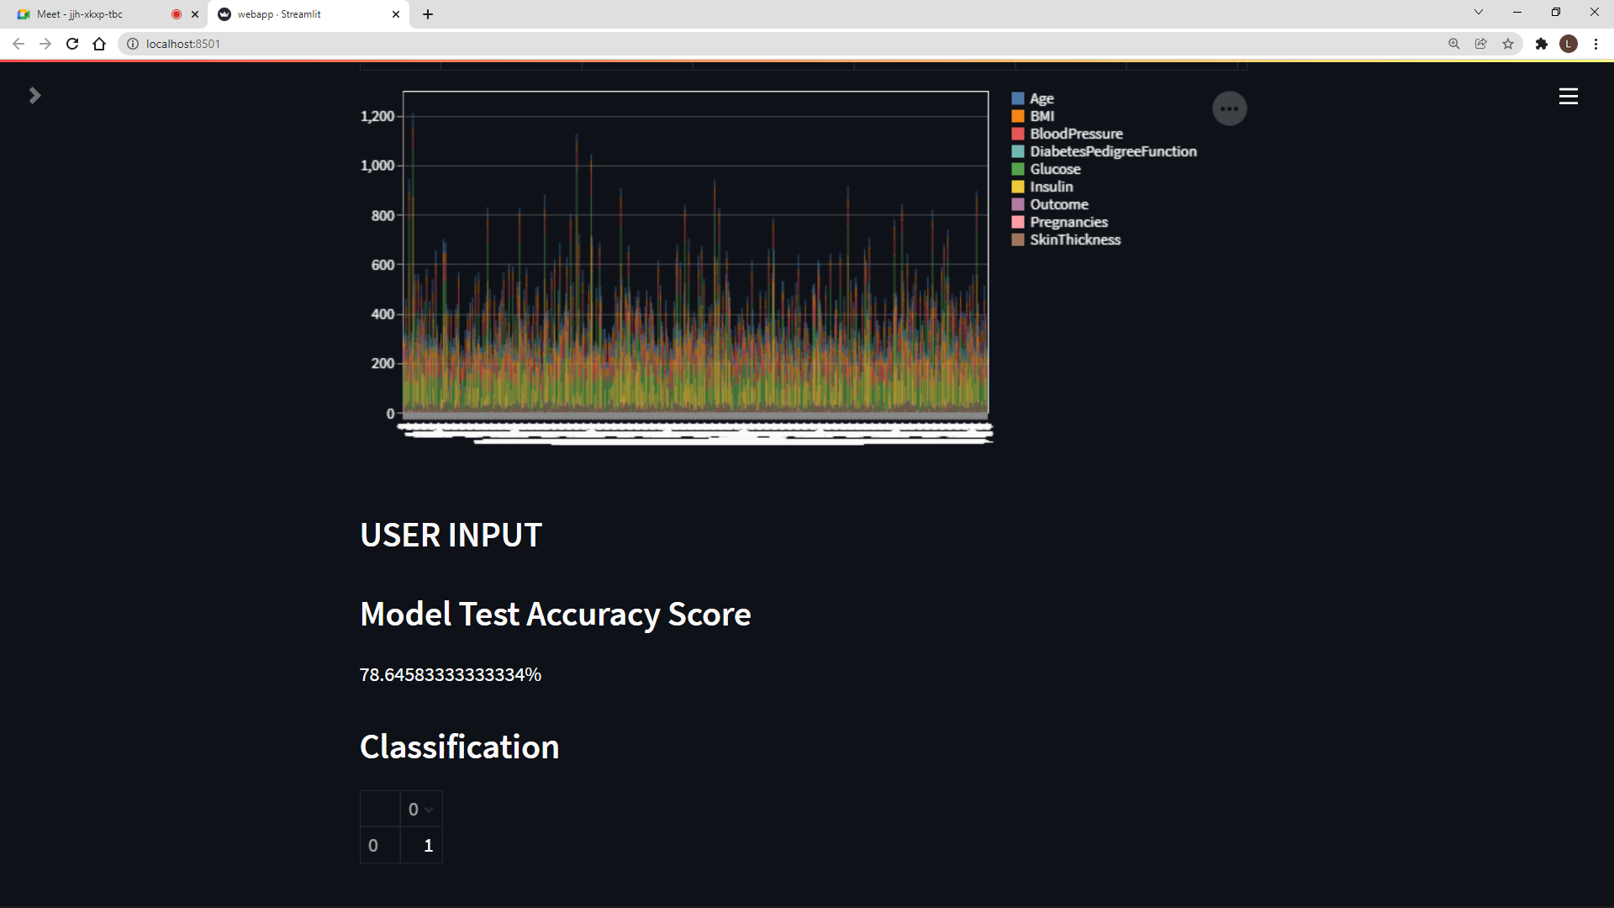
SCREENSHOT

Slide 18
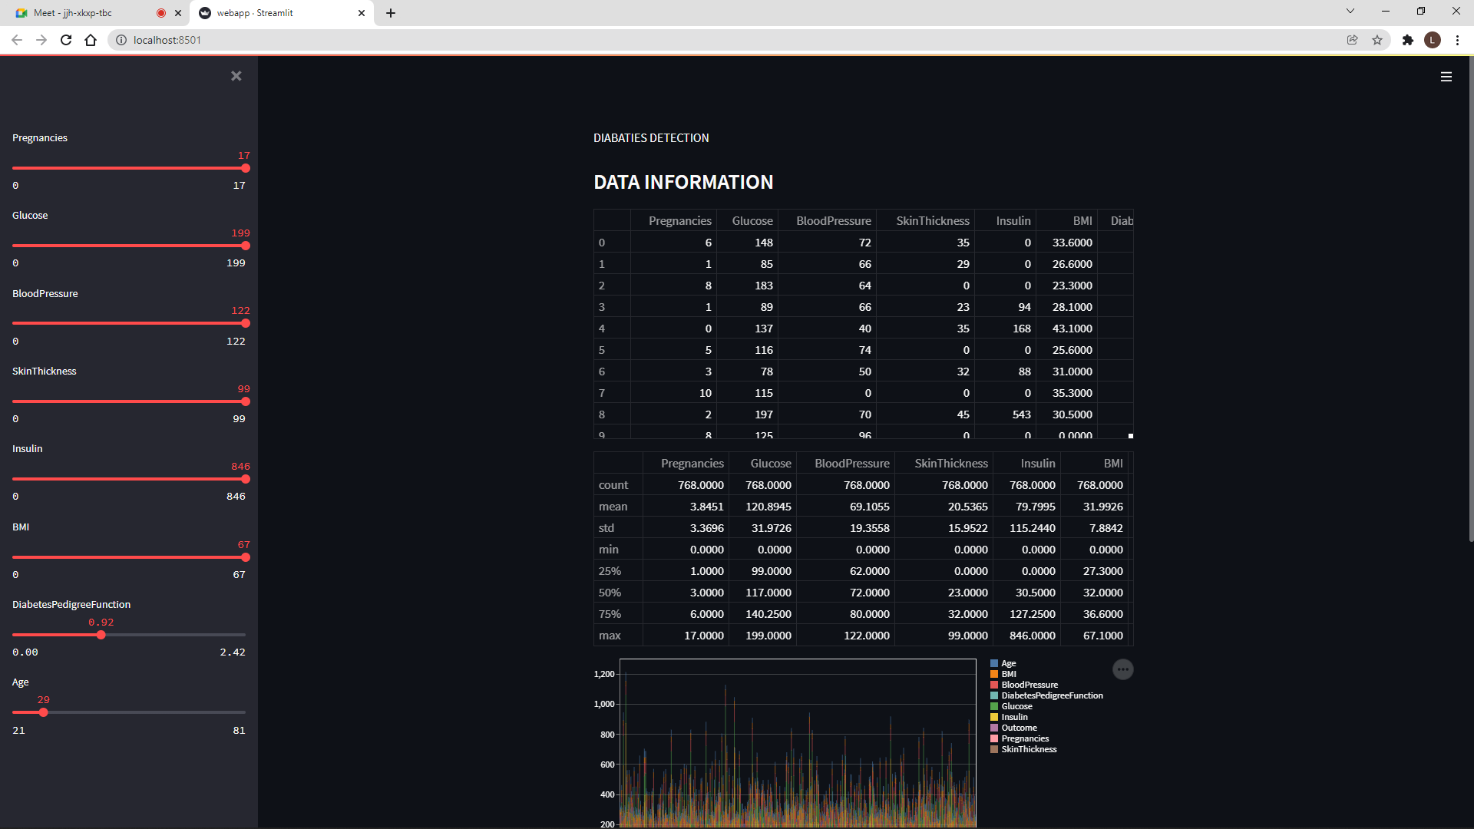
SCREENSHOT

Slide 19
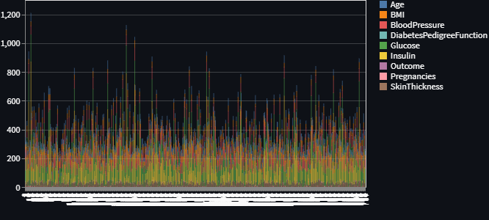
SCREENSHOT

Slide 20
WILL MEET YOU IN THE NEXT MODULES SOON!! THANK YOU

